Slide 1
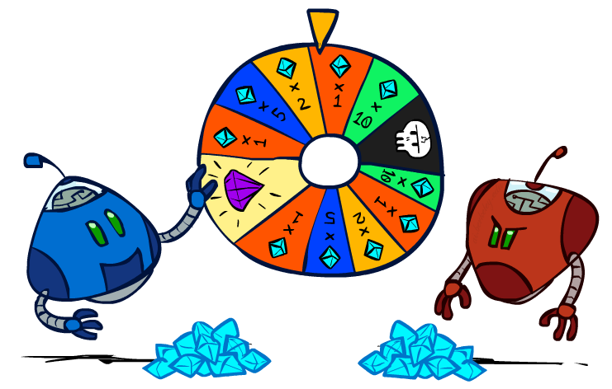
CS 188: Artificial Intelligence
Rational Decisions
Instructor: Stuart Russell and Peyrin Kao
University of California, Berkeley
Notes:
Please retain proper attribution and the reference to ai.berkeley.edu. Thanks!

Slide 2

Utilities

Slide 3

Maximum Expected Utility
Principle of maximum expected utility:
A rational agent should chose the action that maximizes its expected utility, given its knowledge
Questions:
Where do utilities come from?
How do we know such utilities even exist?
How do we know that averaging even makes sense?
What if our behavior (preferences) can’t be described by utilities?

Slide 4
The need for numbers
0
40
20
30
x²
0
1600
400
900
For worst-case minimax reasoning, terminal value scale doesn’t matter
We just want better states to have higher evaluations (get the ordering right)
The optimal decision is invariant under any monotonic transformation
For average-case expectimax reasoning, we need magnitudes to be meaningful

Slide 5

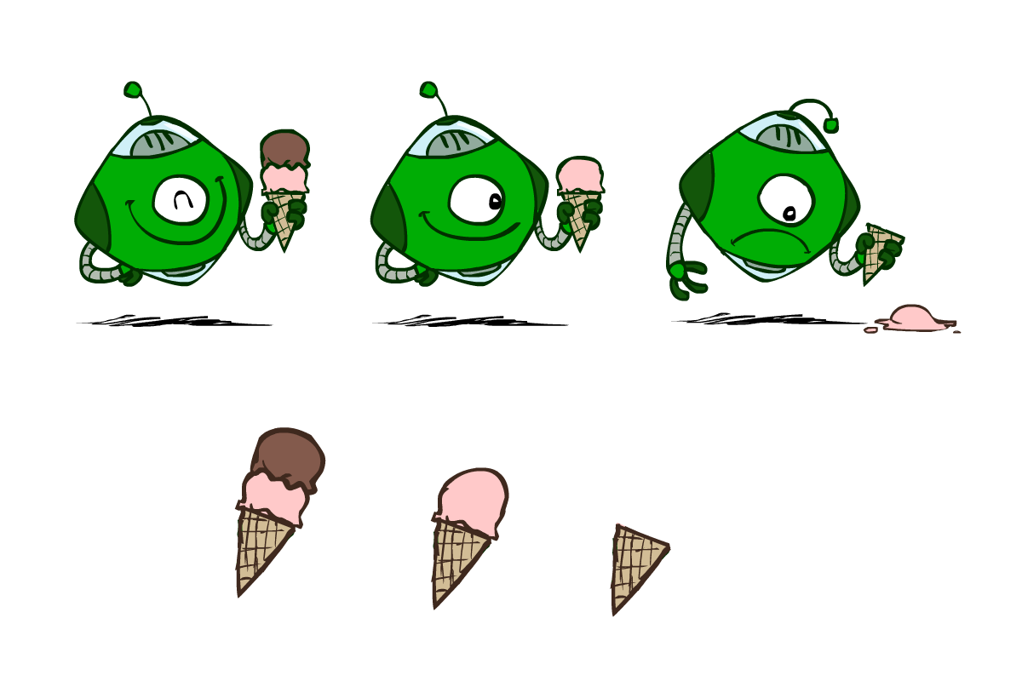
Utilities
Utilities are functions from outcomes (states of the world) to real numbers that describe an agent’s preferences
Where do utilities come from?
In a game, may be simple (+1/-1)
Utilities summarize the agent’s goals
Theorem: any “rational” preferences can be summarized as a utility function
We hard-wire utilities and let behaviors emerge
Why don’t we let agents pick utilities?
Why don’t we prescribe behaviors?

Slide 6

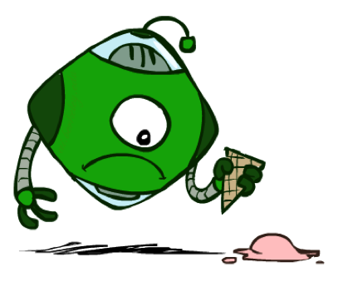

Utilities: Uncertain Outcomes
Getting ice cream
Get Single
Get Double
Oops
Whew!

Slide 7
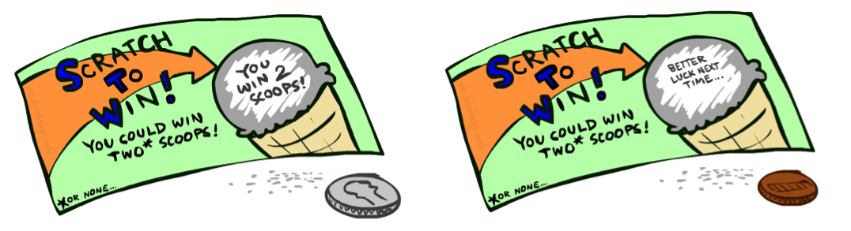
Preferences
A Prize
A Lottery
An agent must have preferences among:
Prizes: A, B, etc.
Lotteries: situations with uncertain prizes
L = [p, A; (1-p), B]
Notation:
Preference: A > B
Indifference: A ~ B
A
p 1-p
A B

Slide 8
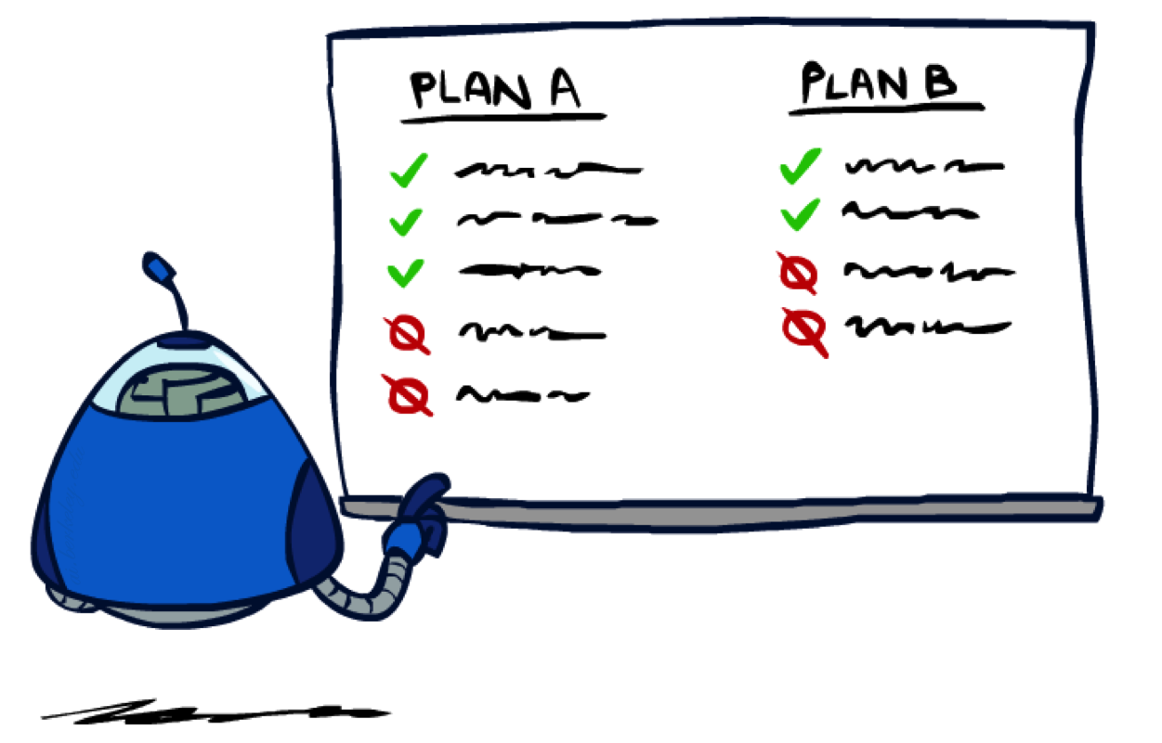
Rationality

Slide 9
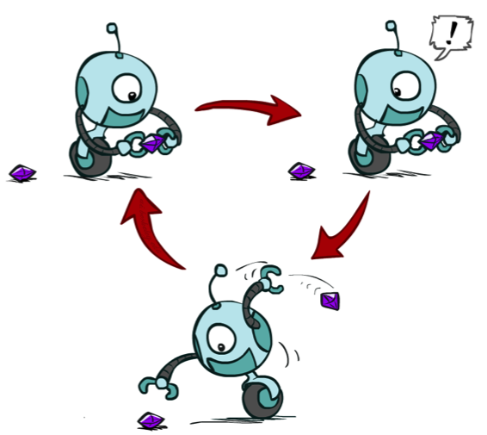
Rational Preferences
We want some constraints on preferences before we call them rational, such as:
For example: an agent with intransitive preferences can
be induced to give away all of its money
If B > C, then an agent with C would pay (say) 1 cent to get B
If A > B, then an agent with B would pay (say) 1 cent to get A
If C > A, then an agent with A would pay (say) 1 cent to get C
Axiom of Transitivity: (A > B) ∧ (B > C) ⇒ (A > C)
Notes:
Apple, banana, carrot

Slide 10

Rational Preferences
The Axioms of Rationality
Orderability:
(A > B) ∨ (B > A) ∨ (A ~ B)
Transitivity:
(A > B) ∧ (B > C) ⇒ (A > C)
Continuity:
(A > B > C) ⇒ ∃p [p, A; 1-p, C] ~ B
Substitutability:
(A ~ B) ⇒ [p, A; 1-p, C] ~ [p, B; 1-p, C]
Monotonicity:
(A > B) ⇒
(p ≥ q) ⇔ [p, A; 1-p, B] ≥ [q, A; 1-q, B]
Theorem: Rational preferences imply behavior describable as maximization of expected utility

Slide 11
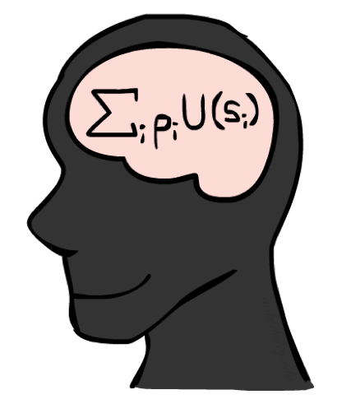
MEU Principle
Theorem [Ramsey, 1931; von Neumann & Morgenstern, 1944]
Given any preferences satisfying these constraints, there exists a real-valued
function U such that:
U(A) ≥ U(B) ⇔ A ≥ B
U([p₁,S₁; … ; p_{n},S_{n}]) = p₁U(S₁) + … + p_{n}U(S_{n})
I.e. values assigned by U preserve preferences of both prizes and lotteries!
Optimal policy invariant under positive affine transformation U’ = aU+b, a>0
Maximum expected utility (MEU) principle:
Choose the action that maximizes expected utility
Note: rationality does not require representing or manipulating utilities and probabilities
E.g., a lookup table for perfect tic-tac-toe

Slide 12
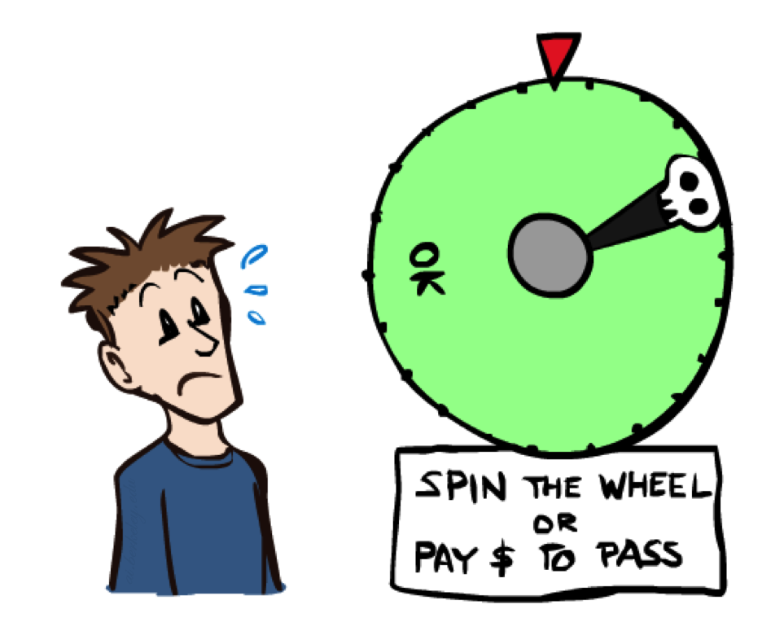
Human Utilities

Slide 13


Human Utilities
Utilities map states to real numbers. Which numbers?
Standard approach to assessment (elicitation) of human utilities:
Compare a prize A to a standard lottery L_{p} between
“best possible prize” u_{T} with probability p
“worst possible catastrophe” u⊥ with probability 1-p
Adjust lottery probability p until indifference: A ~ L_{p}
Resulting p is a utility in [0,1]
Pay $50
0.999999 0.000001
No change
Instant death

Slide 14
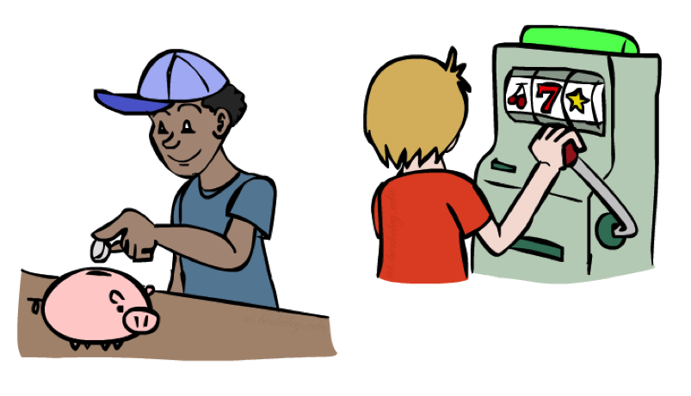
Money
Money does not behave as a utility function, but we can talk about the utility of having money (or being in debt)
Given a lottery L = [p, $X; (1-p), $Y]
The expected monetary value EMV(L) = pX + (1-p)Y
The utility is U(L) = pU($X) + (1-p)U($Y)
Typically, U(L) < U( EMV(L) )
In this sense, people are risk-averse
E.g., how much would you pay for a lottery ticket L=[0.5, $10,000; 0.5, $0]?
The certainty equivalent of a lottery CE(L) is the cash amount such that CE(L) ~ L
The insurance premium is EMV(L) - CE(L)
If people were risk-neutral, this would be zero!
Notes:
Draw Jensen’s for utility curve

Slide 15
Post-decision Disappointment: the Optimizer’s Curse
Usually we don’t have direct access to exact utilities, only estimates
E.g., you could make one of k investments
An unbiased expert assesses their expected net profit V₁,…,V_{k}
You choose the best one V*
With high probability, its actual value is considerably less than V*
This is a serious problem in many areas:
Future performance of mutual funds
Efficacy of drugs measured by trials
Statistical significance in scientific papers
Winning an auction
Suppose true net profit is 0
and estimate ~ N(0,1);
Max of k estimates:

Slide 16
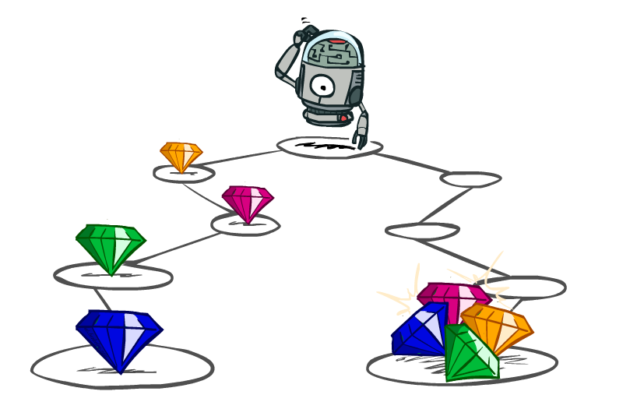
Utilities of Sequences

Slide 17
Utilities of Sequences
What preferences should an agent have over prize sequences?
More or less?
Now or later?
[1, 2, 2]
or
[2, 3, 4]
[0, 0, 1]
or
[1, 0, 0]

Slide 18
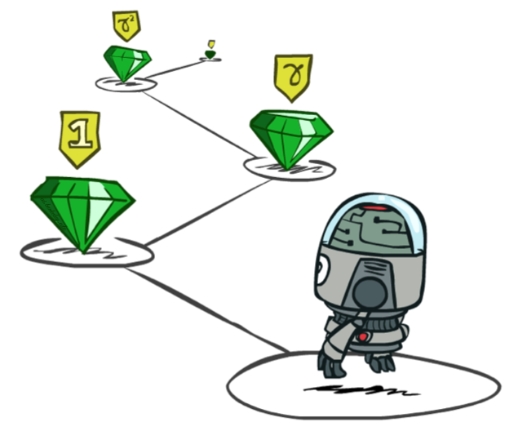
Stationary Preferences
Theorem: if we assume stationary preferences:
[a₁, a₂, …] > [b₁, b₂, …] ⇔ [c, a₁, a₂, …] > [c, b₁, b₂, …]
then there is only one way to define utilities:
Additive discounted utility:
U([r₀, r₁, r₂,…]) = r₀ + γr₁ + γ²r₂ + …
where γ ∈ [0,1] is the discount factor

Slide 19
Invariance for sequences
Invariance for utilities (reminder):
Optimal policy invariant under positive affine transformation U’ = aU+b, a>0
Invariance for rewards:
Optimal policy is also invariant under potential transformation:
R’(s,a,s’) = R(s,a,s’) + γ Φ(s’) - Φ(s)
where Φ is any function of state
These shaping rewards can massively speed up RL
Soccer example: R(s,a,s’) = +3 for a win, +1 for a draw, 0 for a loss
Φ(s) = (100 * goal difference) + (distance to goal / D) + 0.1(possession)

Slide 20
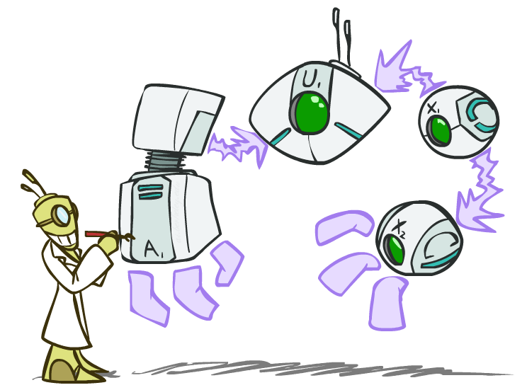
Decision Networks

Slide 21




Decision Networks
Umbrella
U
Weather
Forecast
Notes:
There exists a ghostbusters demo

Slide 22
Decision Networks
Decision network = Bayes net + Actions + Utilities
Action nodes (rectangles, cannot have parents, will have value fixed by algorithm)
Utility nodes (diamond, depends on action and chance nodes)
Decision algorithm:
Fix evidence e
For each possible action a
Fix action node to a
Compute posterior P(W|e,a) for parents W of U
Compute expected utility ∑_{w} P(w|e,a) U(a,w)
Return action with highest expected utility
Umbrella
U
Weather
Bayes net inference!
Forecast
Notes:
There exists a ghostbusters demo

Slide 23

Example: Take an umbrella?
Decision algorithm:
Fix evidence e
For each possible action a
Fix action node to a
Compute posterior P(W|e,a) for parents W of U
Compute expected utility of action a: ∑_{w} P(w|e,a) U(a,w)
Return action with highest expected utility
A | W | U(A,W)
leave | sun | 100
leave | rain | 0
take | sun | 20
take | rain | 70
Bayes net inference!
Umbrella
U
W | P(W)
sun | 0.7
Umbrella = leave
EU(leave|F=bad) = ∑_{w} P(w|F=bad) U(leave,w)
Weather
= 0.34x100 + 0.66x0 = 34
W | P(W|F=bad)
sun | 0.34
rain | 0.66
Umbrella = take
EU(take|F=bad) = ∑_{w} P(w|F=bad) U(take,w)
= 0.34x20 + 0.66x70 = 53
W | P(F=bad|W)
sun | 0.17
rain | 0.77
Forecast
=bad
Optimal decision = take!

Slide 24
Decision network with utilities on outcome states
Wet | FeelStupid | U
dry | false | 100
wet | true | 0
dry | true | 20
damp | false | 70
Umbrella
Wet
W | P(W)
sun | 0.7
U
FeelStupid
Weather
W | P(F=bad|W)
sun | 0.17
rain | 0.77
Here, U is a true utility.
With an action node as parent, it is
sometimes called a Q-value
Forecast
=bad

Slide 25
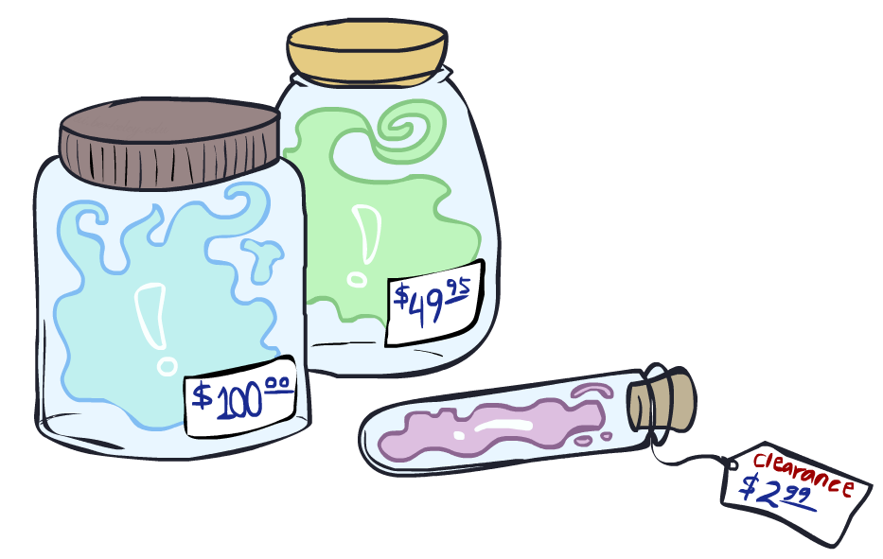
Value of Information

Slide 26
Value of information
Suppose you haven’t yet seen the forecast
EU(leave | ) = 0.7x100 + 0.3x0 = 70
EU(take | ) = 0.7x20 + 0.3x70 = 35
What if you look at the forecast?
If Forecast=good
EU(leave | F=good) = 0.89x100 + 0.11x0 = 89
EU(take | F=good) = 0.89x20 + 0.11x70 = 25
If Forecast=bad
EU(leave | F=bad) = 0.34x100 + 0.66x0 = 34
EU(take | F=bad) = 0.34x20 + 0.66x70 = 53
P(Forecast) = <0.65,0.35>
Expected utility given forecast
= 0.65x89 + 0.35x53 = 76.4
Value of information = 76.4-70 = 6.4
Umbrella
U
Weather
Forecast
leave
take
70
35
observe F
Bayes net inference!
0.65
0.35
Umbrella
Umbrella
U
U
Weather
Weather
good
bad
leave
take
leave
take
89
25
34
53

Slide 27

Video of Demo Ghostbusters with VPI

Slide 28
Value of information contd.
General idea: value of information = expected improvement in decision quality from observing value of a variable
E.g., oil company deciding on seismic exploration and test drilling
E.g., doctor deciding whether to order a blood test
E.g., person deciding on whether to look before crossing the road
Key point: decision network contains everything needed to compute it!
VPI(E_{i} | e) = [ ∑_{ei} P(e_{i} | e) max_{a} EU(a|e_{i},e) ] - max_{a} EU(a|e)

Slide 29
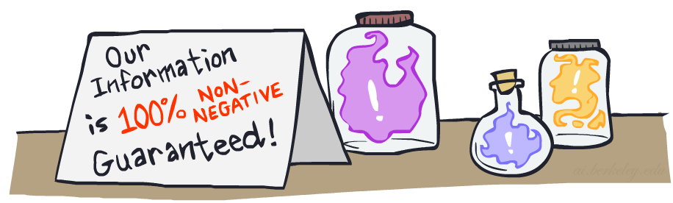

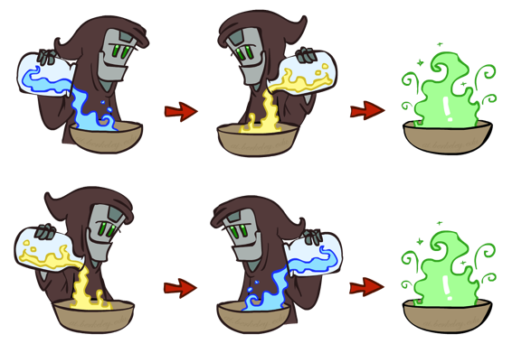
VPI Properties
VPI is non-negative! VPI(E_{i} | e) ≥ 0
VPI is not (usually) additive: VPI(E_{i} , E_{j} | e) ≠ VPI(E_{i} | e) + VPI(E_{j} | e)
VPI is order-independent: VPI(E_{i} , E_{j} | e) = VPI(E_{j} , E_{i} | e)

